Slide 1
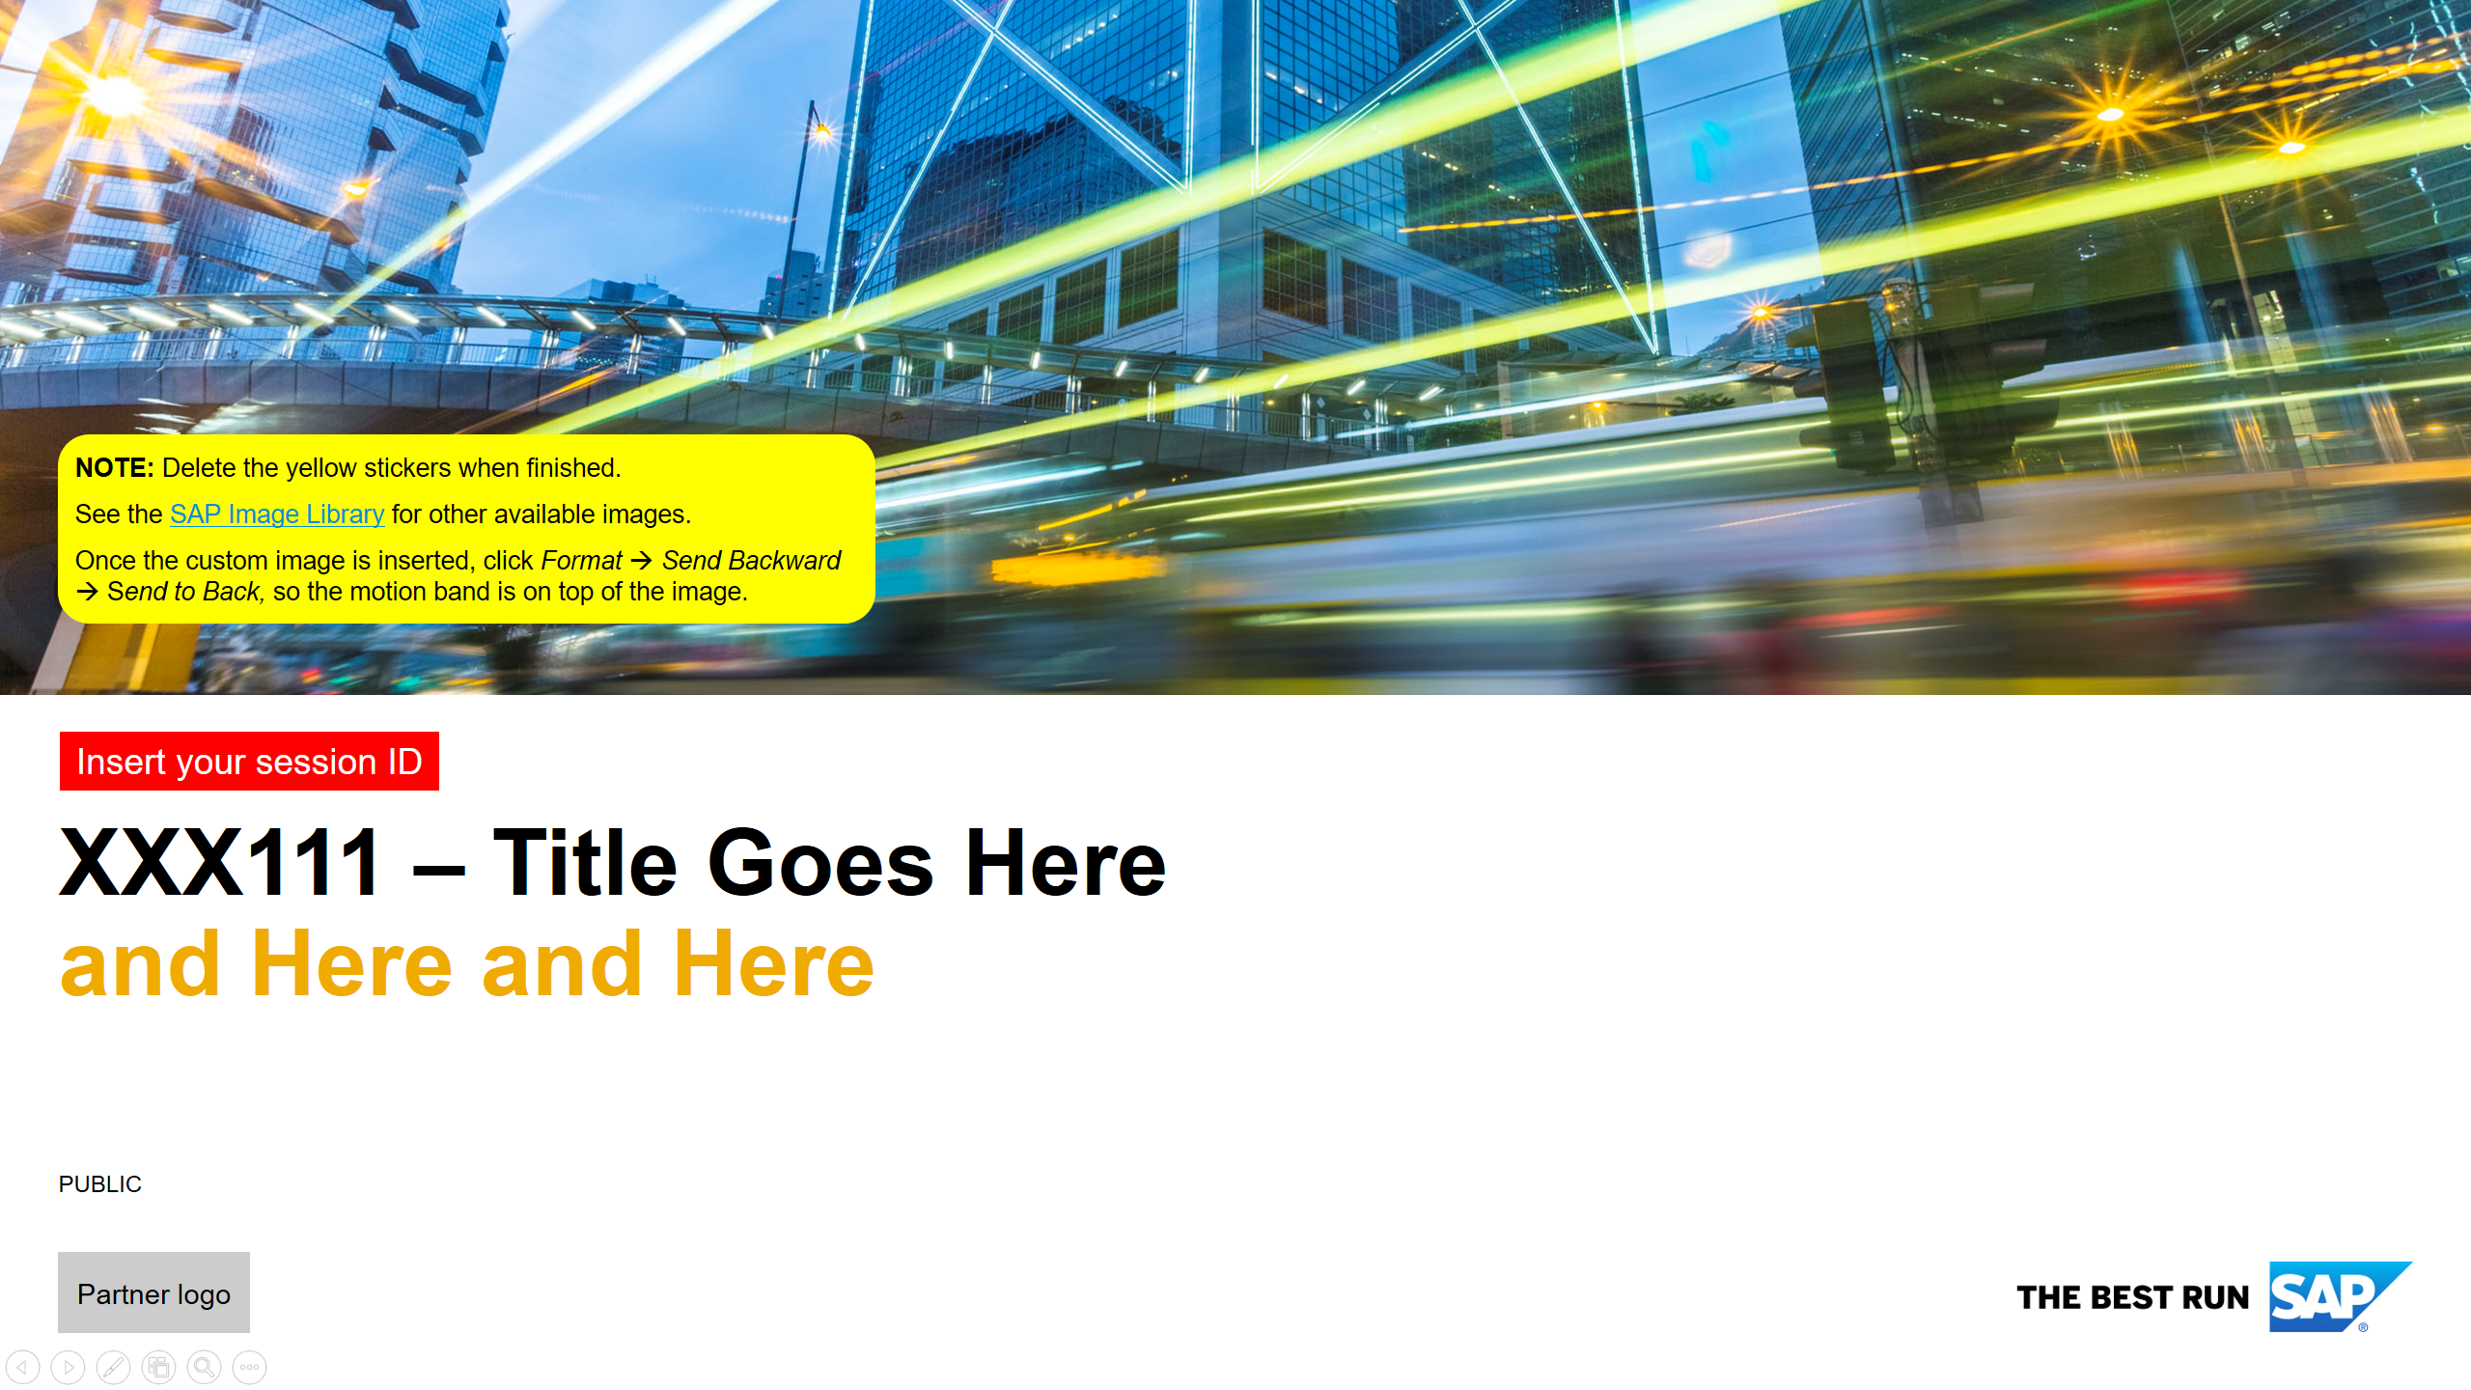

How to use this template:
This slide is for your information only. Please delete it before check-in.
Name your presentation file with the session ID: “XXX111.pptx” Use “XXX111_withnotes.pptx” instead, if you want your slide notes to be published in the pdf file for attendees.
Update the file’s properties (File > Info > Properties/Related People) with: → Your session’s ID and title (format: “XXX111 – Presentation Title”) → The author’s full name; remove all others
Use a title slide. The image in this template deck is only a sample. See SAP Image Library for other available images.
Enter your session ID and title on the title slide.
Don’t change the font style, font size, or font color of your slides’ headers.
Use the notes section if you want to include additional notes for the audience. You can delete all notes with the “Presentation Wizard 2018.4” add-in (available in Software Corner) before submitting (if you DON’T want to share your notes).
Do a spelling and grammar check before submitting.
SAP Brand Tools: Use only approved product names. Check here: www.sapbrandtools.com/naming-center/#/search/status-search
SAPterm: Use only approved terminology. Check here: http://sapterm.com/application_page.htm
Use this ppt deck as the “visual support” for your presentation. Instead of writing down nearly every word you are planning to say, rely on your demo. If you want to share more text with the attendees, put it in the notes of the slide.
If you want to reference other SAP TechEd sessions, please use this element and insert the session ID:
XXX111

Slide 2

DAT368 – Python Wrangling for SAP HANA Application Developers
Partner logo
Notes:
Hello and welcome to workshop session DAT368, Python Wrangling for SAP HANA Application Developers. I'm <speaker name> and I work as a <title> for the ISV A-Team. As such, I often have occasion to work with partners who are moving an existing solution to SAP HANA or are developing new solutions using HANA and other SAP technologies. Today's workshop will focus on using the python development language in HANA XS Advanced micro service application development. Since XS Advanced is decended from the general cloud foundry approach to micro services, you'll find the most things we cover today will also apply when deploying to cloud environments as well. In fact we'll strive to follow best practices that will enable us to deploy applications with python based components as flexibly as possible. If there are details that apply specifically to on-premis or cloud environments, I'll attempt to point them out as we go along.

Slide 3

Speakers 2018
SAP TechEd Las Vegas October 2–5, 2018 | Andrew Lunde Harini Gunabalan
SAP TechEd Barcelona October 23–25, 2018 | Aron MacDonald Harini Gunabalan
SAP TechEd Bangalore November 28–30, 2018 | Abhijeet G Chinchanikar Arun Srinivasan
Notes:
Again my name is <speaker name> and today I’m joined by <assistant name> who will also be helping facilitate today’s workshop.

Slide 4
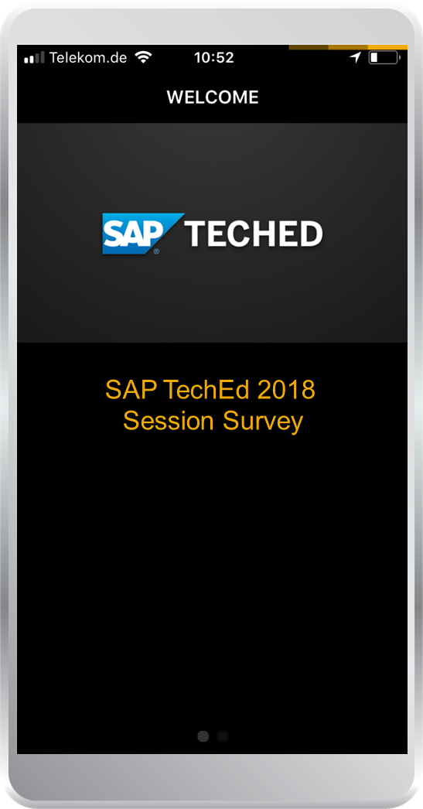

Take the session survey.
We want to hear from you! Be sure to complete the session evaluation on the SAP TechEd mobile app.
Download the app from iPhone App Store or Google Play.
Notes:
I know it’s a pain and everyone is anxious to get to the next session, but I do ask that you please fill out the survey for this workshop as your comments truly do help us improve the workshop content in the future.

Slide 5
Disclaimer
NOTE: Delete the red stickers when finished. This slide is MANDATORY and MUST exist in your presentation.
The information in this presentation is confidential and proprietary to SAP and may not be disclosed without the permission of SAP. Except for your obligation to protect confidential information, this presentation is not subject to your license agreement or any other service or subscription agreement with SAP. SAP has no obligation to pursue any course of business outlined in this presentation or any related document, or to develop or release any functionality mentioned therein.
This presentation, or any related document and SAP's strategy and possible future developments, products and or platforms directions and functionality are all subject to change and may be changed by SAP at any time for any reason without notice. The information in this presentation is not a commitment, promise or legal obligation to deliver any material, code or functionality. This presentation is provided without a warranty of any kind, either express or implied, including but not limited to, the implied warranties of merchantability, fitness for a particular purpose, or non-infringement. This presentation is for informational purposes and may not be incorporated into a contract. SAP assumes no responsibility for errors or omissions in this presentation, except if such damages were caused by SAP’s intentional or gross negligence.
All forward-looking statements are subject to various risks and uncertainties that could cause actual results to differ materially from expectations. Readers are cautioned not to place undue reliance on these forward-looking statements, which speak only as of their dates, and they should not be relied upon in making purchasing decisions.
Notes:
You’ve all seen the standard disclaimer so I won’t dwell on it.

Slide 6

Agenda
Why Python?
Why Python? Why microservices? Why MTA? Why on prem?
Module lifecycle
Details
Tools
Details
About the Exercises
Details
Notes:
We’ll spend the first 15-20 minutes going over the main topics of this workshop in order to have them clearly in your mind as you work through the exercises. I don’t want you to mindlessly perform the exercise tasks. Take time to think of how what you’re doing relates to the overall goals of the workshop.
<survey the audience for python and/or micro service development experience>
<invite the audience to interrupt and ask questions as we go along>

Slide 7
Divider Page

Slide 8
Why Python?
All the rage (at least for machine learning)

Slide 9
Python is expected to grow faster for machine learning
https://medium.com/@UdacityINDIA/why-use-python-for-machine-learning-e4b0b4457a77
Notes:
https://medium.com/@UdacityINDIA/why-use-python-for-machine-learning-e4b0b4457a77

Slide 10
Why Python?
All the rage (at least for machine learning)
Existing Code (porting destroys prior confidence)
Appropriateness for Task
Want to work with images — numpy, opencv, scikit
Want to work in text — nltk, numpy, scikit
Want to work in audio — librosa
Want to solve machine learning problem — pandas, scikit
Want to see the data clearly — matplotlib, seaborn, scikit
Want to use deep learning — tensorflow, pytorch
Want to do scientific computing — scipy
Want to integrate web applications — Django

Slide 11
Why microservices?
There is only one codebase per app(module), but there will be many deploys of the app. A deploy is a running instance of the app. https://12factor.net/codebase
Follow the Single Responsibility Principle (does one task well)
Resilient/Flexible – failure in one service does not impact other services
High scalability – demanding services can be deployed in multiple servers to enhance performance and keep away from other services so that they don’t impact other services.
Easy to enhance – less dependency and easy to change and test
Low impact on other services – being an independent service, this has less chance to impact other services
Easy to understand since they represent the small piece of functionality
Ease of deployment (also flexible to deploy in different environments like cloud or on premis)
Freedom to choose technology – allows you to choose language that is best suited for a particular functionality (Python anyone?)

Slide 12
Why (what is) an MTA?
SAP has built upon microservices the concept of a Multi-Target Application or MTA.
The MTA specification addresses this life-cycle and orchestration complexity of continuous deployment for cloud and on-premise platforms. We use the following definition:
A multi-target application (MTA) is comprised of multiple parts (“modules”), created with different technologies and deployed to different targets, but with a single, common lifecycle.
The MTA addresses the deployment challenges by isolating the developer from target-specific native tools (like XS push), via a formal target-independent application model. Developers describe the modules of the application, the interdependencies on other modules, MTAs and (micro) services, and required and exposed interfaces. An MTA-aware application lifecycle management framework validates, orchestrates and automates the MTA deployment on premise and on cloud platforms.

Slide 13
Why (what is) an MTA? (continued)
Isolation is provided by run-time
Combined with a specific buildpack that completes the execution environment
Can be started/stopped/scaled
Does work appropriate to python
BROWSER
R
On Premise System or Multi-Tennant Platform Router
R
Execution Agent / Runtime (Docker)
Multi Target Application (MTA)
Application Router Module (NodeJS)
R
R
R
R
R
R
NodeJS
Module
(XSJS)
Java
Module
PHP
Module
Python
Module
Python
Module
Static Web
Resources
R
Services
Job Scheduler
HANA
User Authentication
and Authorization

Slide 14
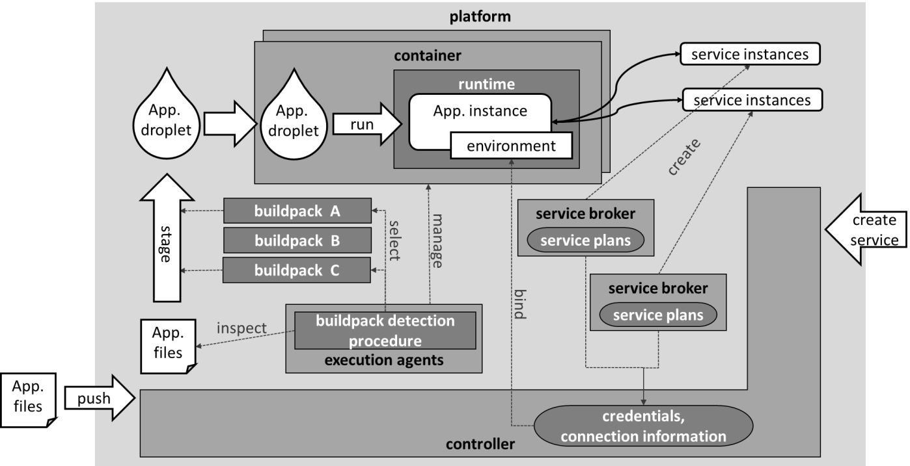
Module Staging and Execution
Notes:
Applications are deployed to the platform by calling the “push” operation of the controller API. Pushing an application works as follows:
First the files of the application are uploaded to the platform.
Programs called buildpacks create archives that are self-contained and ready-to run executable applications called droplet. This process is called staging.
Typical activities executed by buildpacks are downloading required libraries or server code as well as configuring the application. Different buildpacks exist for the different target runtimes such as Java or Node.js or in our case Python. In order to find a suitable buildpack, a buildpack detection procedure is executed, which inspects the application files and automatically determines the buildpack to be used for a given application.
In Cloud Foundry the droplets are run by droplet execution agents in containers that provide isolation and resource control.
The application is pulled from the droplet store or blob store every time an instance is created. You can modify a running instance, but your changes will be lost since the deployed version is in the droplet store.
For XS Advanced applications are not isolated by Linux containers but instead by OS process isolation.
It has a blob store for buildpacks, droplets, and application data. XS Advanced OP persists the configuration database and the blob store in SAP HANA.

Slide 15
Buildpack Assembly Process
Isolated Execution Environment (Container)
Python Runtime (runtime.txt)
Python Dependencies (Assembled with PIP)
Python Web Server (Flask, SAP libs/drivers)
Your Python Code
from flask import Flask
from flask import request
... your awesome python worker
If __name__ == ‘__main__’:
app.run(host=‘0.0.0.0’, port=port)
Notes:
First the staging process sets up an isolated execution environment for you module to run in. How this is provided depends on the platform. In cloud foundry it uses a container while XSA uses process isolation. Think of the execution environment like a simplified os with a few critical os tools available but nothing else.
Once execution environment is set up, the buildpack looks at an application file called runtime.txt to decides what version of python runtime is needed. If the desired python runtime is not already available in the system, the staging will fail. It takes the runtime from the blobstore and inserts it into the execution environment. Now the python interpreter is available. Getting the proper python runtime compiled and installed in the system is the main activity of this workshop.
Once we have the python runtime, all the other python dependencies are brought in that your module will need. This is either done by pip when your deployable mtar file is built, or the buildpack brings them in now. If your system doesn’t have access to the internet then this is another time things can fail.
One of the critical dependencies is the Flask(or other HTTP server) component. Keep in mind that every application module must provide it’s own HTTP server to service requests. The module cannot communicate to the outside world with other TCP/IP sockets. Other dependencies are the SAP supplied helper libraries for checking request authorization and also connecting to the HANA database.
Finally, after all this is in place, your code is added and execution of it is started. It’s your application module’s responsibility to verify that requests are coming from your application router and that they are authorized to perform tasks that your python module provides and to store it’s results with the persistence service which in our case is provided by HANA.

Slide 16
Python Workshop Exercises
Web IDE for SAP HANA
Putty SSH Client
Full Python Demo
Notes:
For this exercise, we will be mostly using Putty to SSH into the backend server. Each of you have your own instance of the backend server so your work will only affect you and not anyone else in the workshop. We will also use the Chrome browser to demonstrate where the HANA WebIDE can be used for some of your project work and where it falls short when working with Python.
If we have some time left at the end of the workshop, I’ll a more full-fledged demo where the python module is doing something a bit more interesting.
...on to the exercise.

Slide 17

Demo
Description text

Slide 18
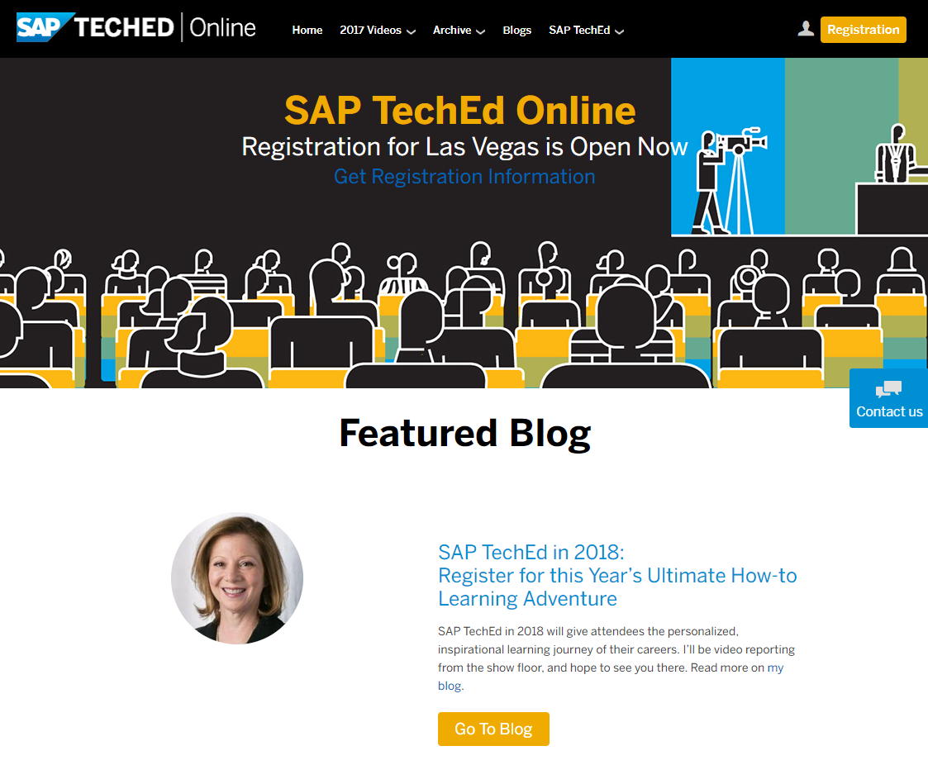
SAP TechEd online / SAP Community
NOTE: Delete the red stickers when finished. This slide is MANDATORY and MUST exist in your presentation.
Access replays of:
Keynotes
SAP TechEd live interviews
Selected lecture sessions
http://sapteched.com/online
Continue your SAP TechEd discussion after the event within SAP Community:
Read and reply to blog posts
Ask your questions
Join conversations
sap.com/community
See all SAP TechEd blog posts

Slide 19

Further information
NOTE: Delete the red stickers when finished. This slide is MANDATORY and MUST exist in your presentation.
Related SAP TechEd content journeys
<YYY1> – <journey title> ….
Related SAP TechEd sessions
<XXX111> – <session title> …. …. ….
Public SAP Web sites
SAP Community: www.sap.com/community SAP products: www.sap.com/products
SAP training and certification opportunities
www.sap.com/education
Please specify the content journey(s) this session appears in AND related content journeys that are relevant for this session.
Please specify the most important related SAP TechEd sessions (3 to 5 max) here. Attendees can find more related sessions by displaying the respective content journey.
Please specify relevant spaces on SAP Community or pages on sap.com related to the session topic.
Please mention relevant related SAP certification and training courses (including those available on the openSAP platform) and learning journeys.

Slide 20


Feedback
Thanks for attending this session.
Contact for further topic inquiries
Please complete your session evaluation for DAT368.
Andrew Lunde
Principal Solution Architect
andrew.lunde@sap.com

Slide 21
Lectures only: Questions for TechEd Journey Badge “exam” pool* / openSAP course SAP TechEd 2018 Recap**
NOTE: Delete the red stickers when finished. LECTURES ONLY: This slide is MANDATORY and MUST exist in your presentation (will be deleted prior to publication).
Please provide 3-4 questions (MANDATORY FOR LECTURES)
Question format: Multiple choice – single select: one correct answer per question, 3 false options
Sequence: correct answer on top, false answers below (will be randomized for assessment)
Difficulty: intermediate (non-trivial but not too detailed / exotic)
Tip: Ask yourself what the main points the attendees should learn from your session. Build the first draft questions around that content.
Make sure the questions can be answered based on the session material
1 <question text>
<correct answer> (correct)
<false answer>
<false answer>
<false answer>
2 <question text>
<correct answer> (correct)
<false answer>
<false answer>
<false answer>
3 <question text>
<correct answer> (correct)
<false answer>
<false answer>
<false answer>
4 <question text>
<correct answer> (correct)
<false answer>
<false answer>
<false answer>
* Item pool for planned TechEd Journey badge “exam”: TechEd attendees will be able to get digital “Knowledge Badges” for working on a TechEd Learning Journey. The assessment will include questions from the sessions and general questions provided by the journey leads.
** Self assessment for openSAP course SAP TechEd 2018 Recap: A selection of recorded lectures will be included in the recap; watchers can do a self-assessment after watching the recording

Slide 22
Agenda
Agenda Item/Divider Headline
Details
Agenda Item/Divider Headline
Details
Agenda Item/Divider Headline
Details
Agenda Item/Divider Headline
Details

Slide 23
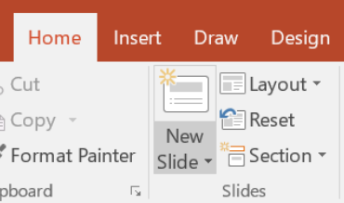
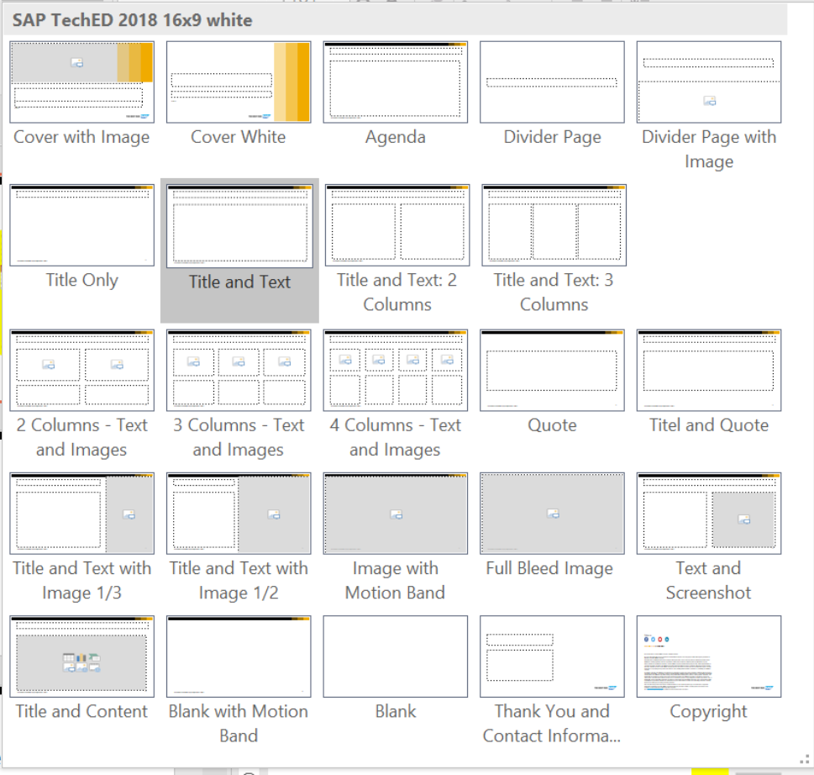
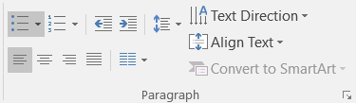
Insert page title (sentence case)
First level
Second level
Third level
NOTE: Delete the yellow stickers when finished.
The text placeholders have different, preformatted text levels. Each level has different formatting (font size, indent, bullet).
To jump between the preformatted text levels, go to Home and use the Increase List Level and Decrease List Level buttons in the Paragraph toolbar.
Type your text in the placeholder.
Click the Increase List Level button in the Paragraph toolbar to go to the next level.
If you need a bulleted list, choose level 2.
Avoid working with spaces, other bullets, or bullets in the wrong level. Only when you use the right levels is it possible to reset the slide layout.
NOTE: Delete the yellow stickers when finished.
When creating a new slide, it is advantageous to apply the appropriate layout in order to use the defined placeholders.
Go to Home and click on New Slide.
The slide layout can be applied even after slides have been finished. Go to Home and click on Layout.

Slide 24
Insert page title (sentence case) Subheadline
First level
Second level
Third level

Slide 25
“Quote goes here and here and here.”
Source

Slide 26
NOTE: Delete the yellow stickers when finished. This slide is for screenshots.

Slide 27
Insert page title (sentence case) Subheadline
First level
Second level
Third level

